Slide 1
Computer Graphics and Multimedia
CS3CO24

Slide 2
UNIT-II

Slide 3
course
2-D Transformation: Translation, Rotation, Scaling, Shearing, Reflection. Inverse Transformation, Homogenous Coordinate System, Matrices Transformation, Composite Transformation. Windowing & Clipping: World Coordinate System, Screen Coordinate System, Viewing Transformation, Line Clipping & Polygon Clipping Algorithms.

Slide 4
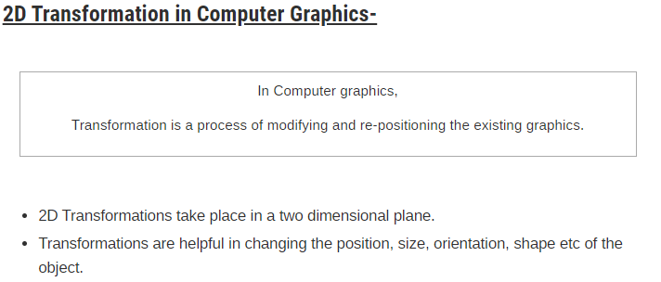
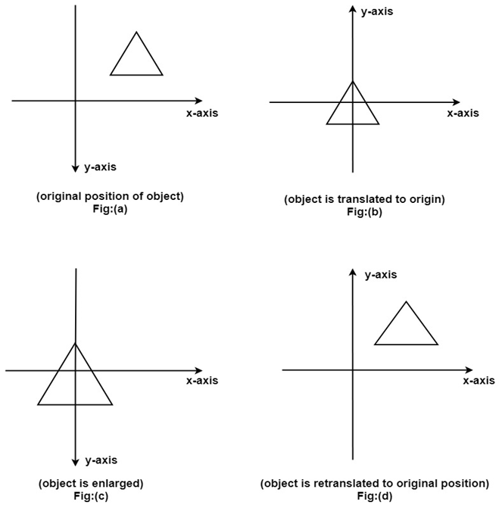

Slide 5
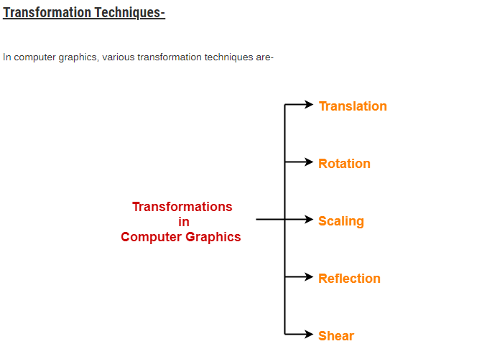
Transformation refers to the mathematical operations or rules that are applied on a graphical image consisting of the number of lines, circles, and ellipses to change its size, shape, or orientation. It can also reposition the image on the screen.

Slide 6
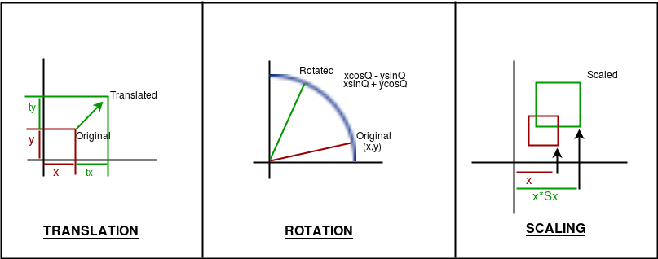
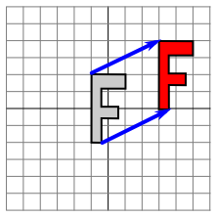
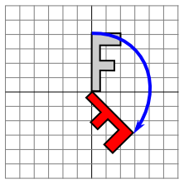
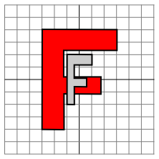

Slide 7
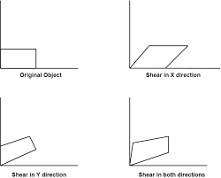
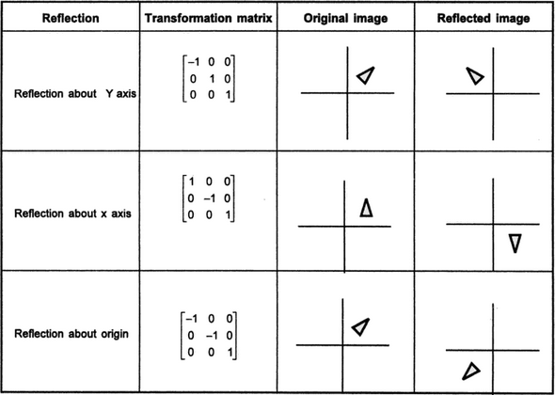
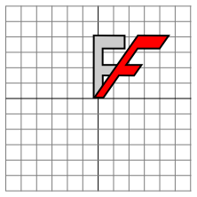
REFLECTION
SHEARING

Slide 8
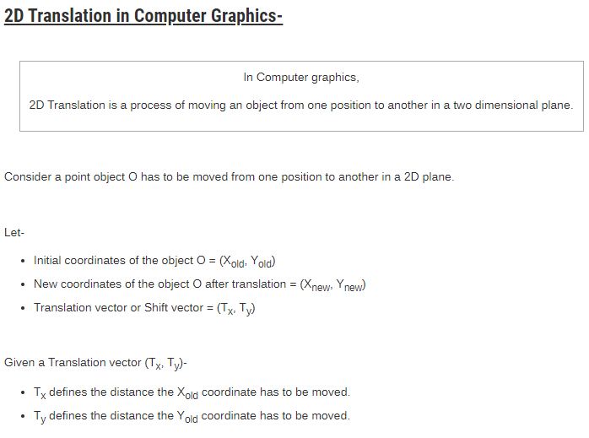
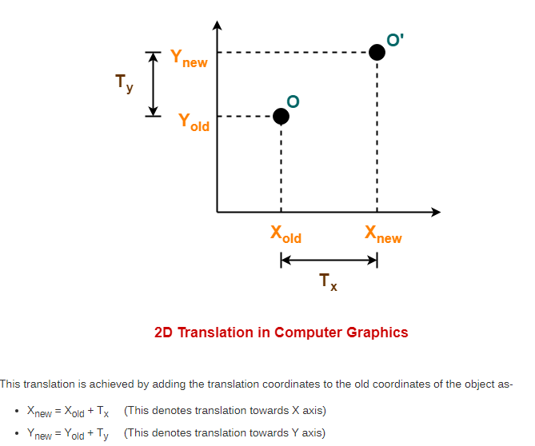

Slide 10
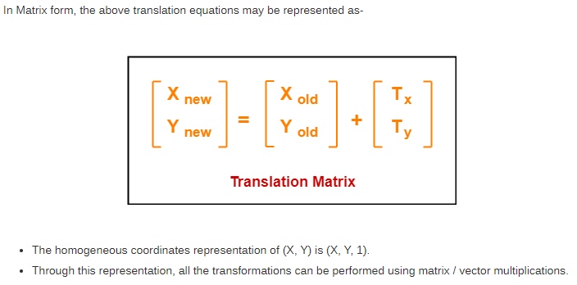

Slide 11
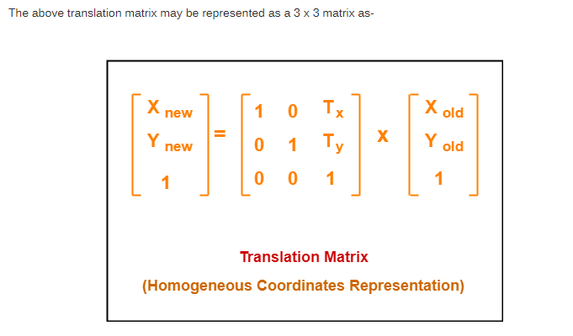

Slide 12
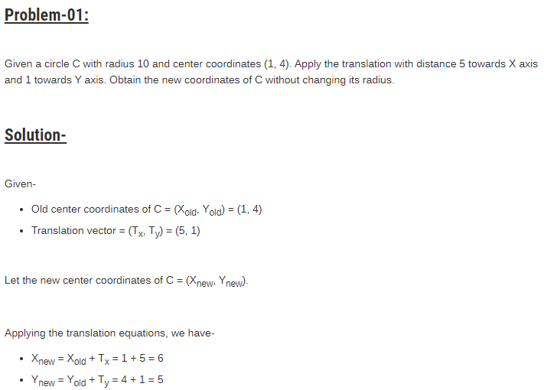

Slide 13
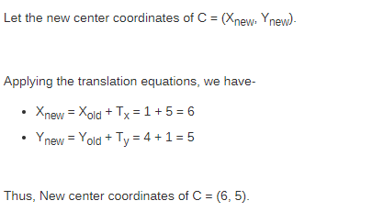

Slide 14
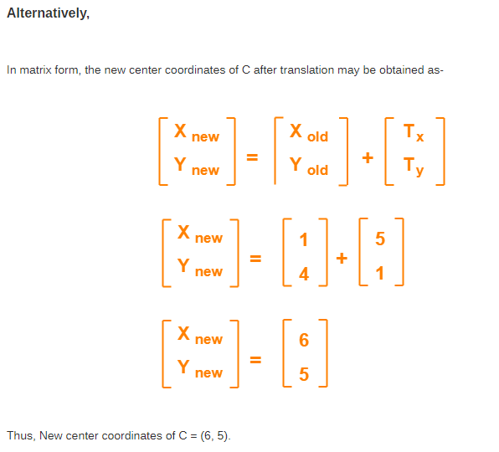

Slide 15
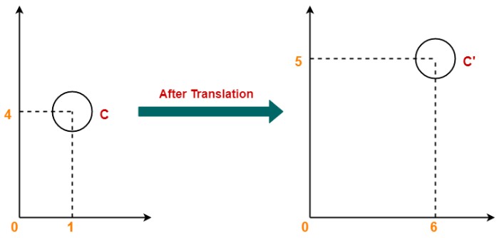

Slide 16
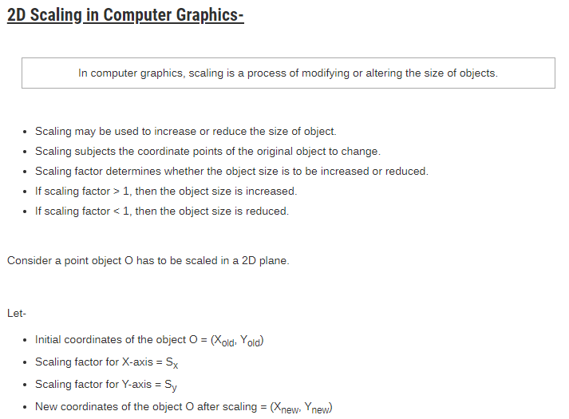
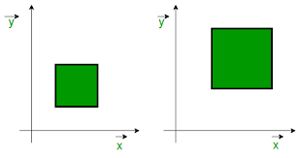

Slide 17
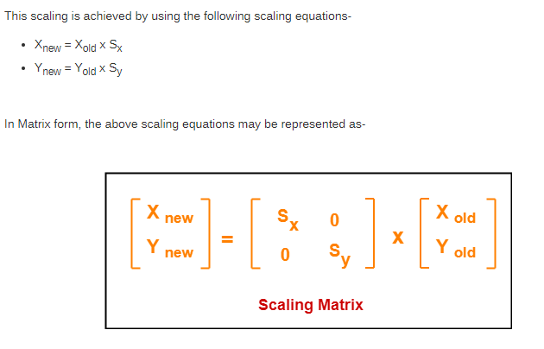

Slide 18
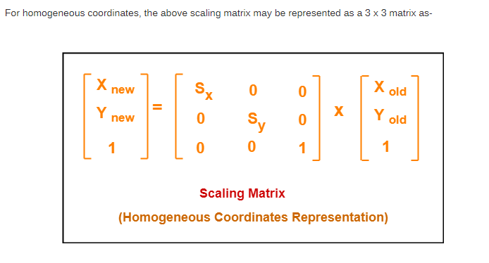

Slide 19
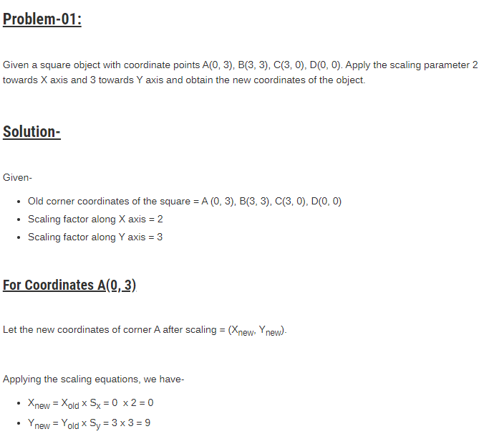

Slide 20
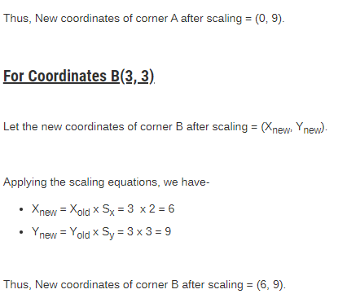
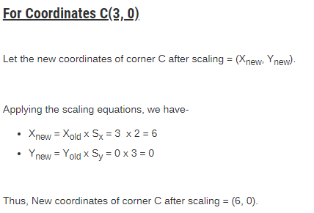

Slide 21
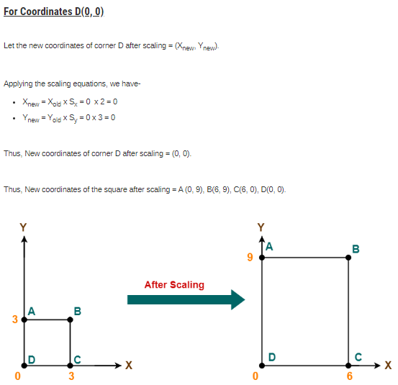

Slide 22
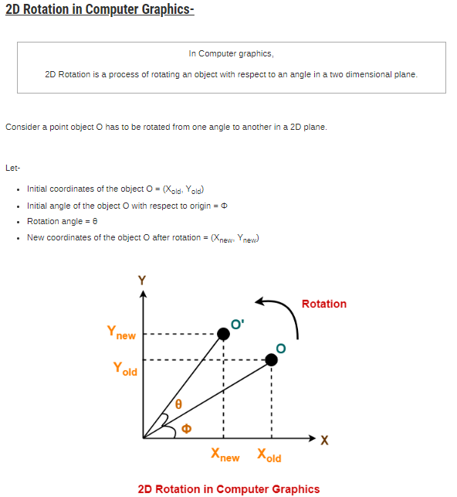

Slide 23
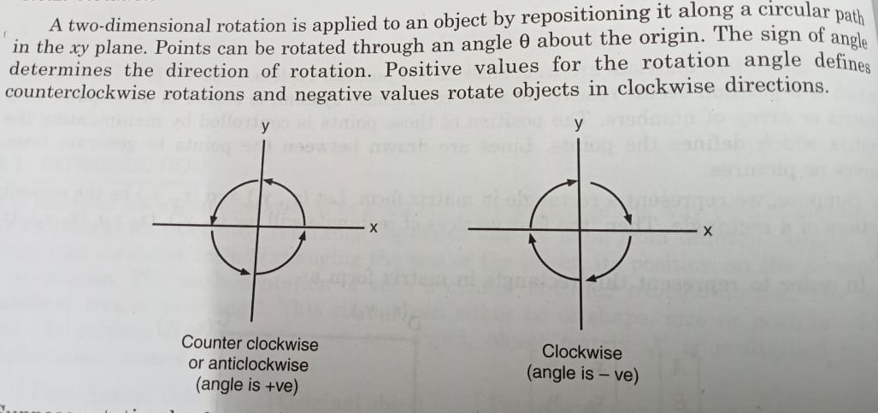

Slide 24
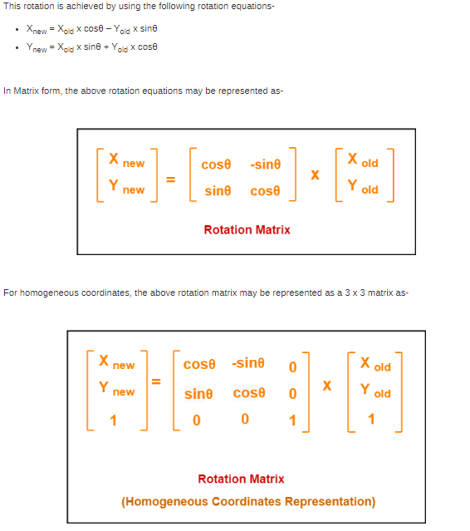

Slide 25
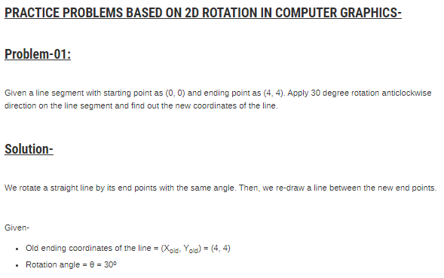

Slide 26
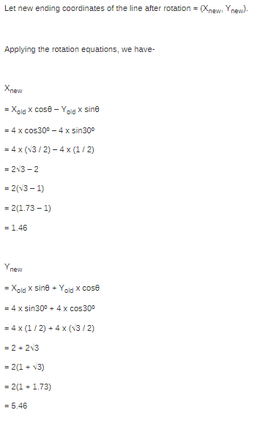

Slide 27
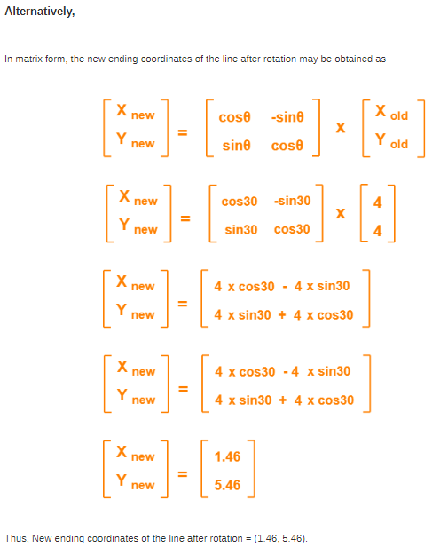

Slide 28
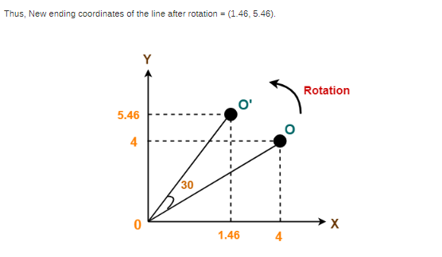

Slide 29
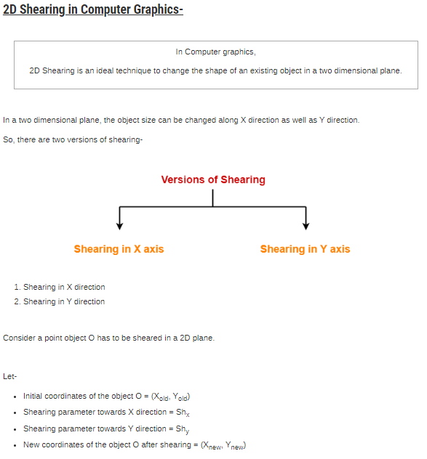

Slide 30
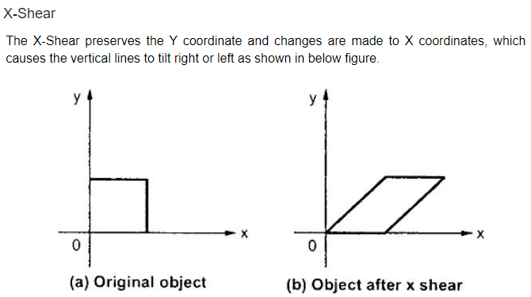
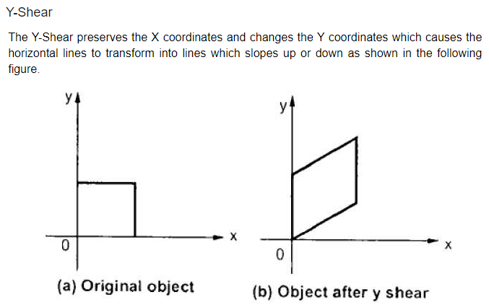

Slide 31
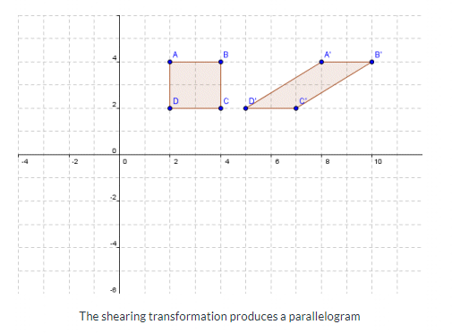

Slide 32
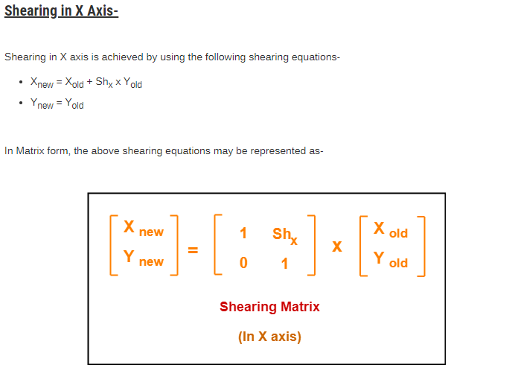

Slide 33
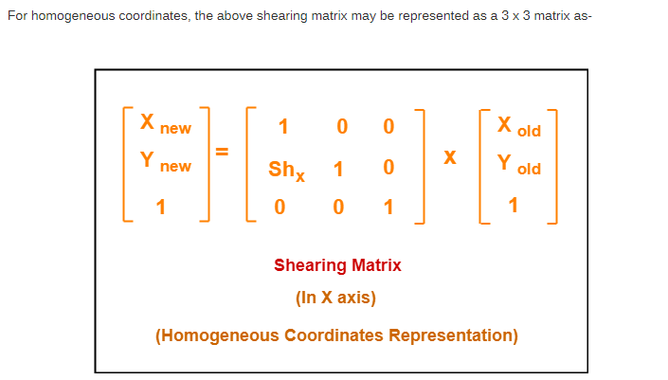

Slide 34
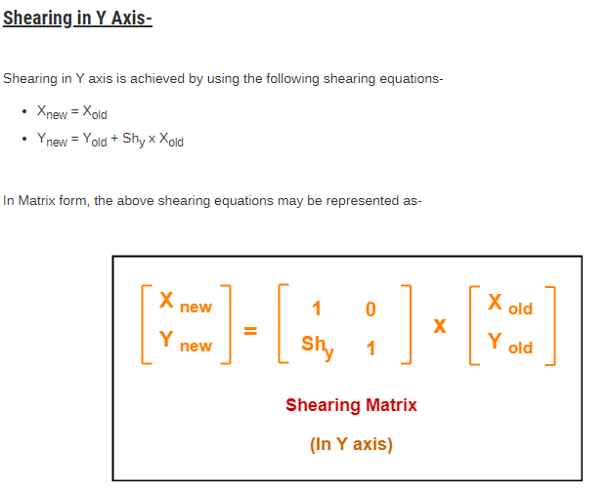

Slide 35
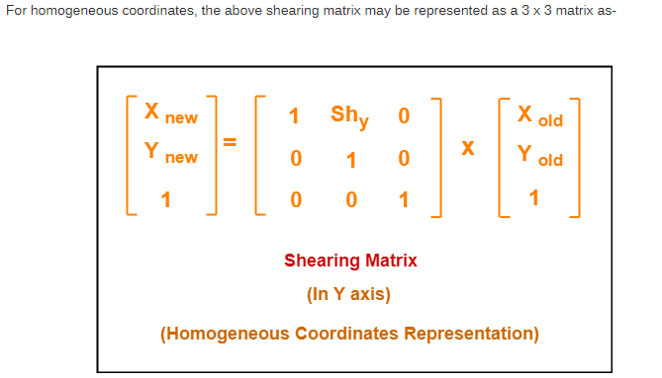

Slide 36
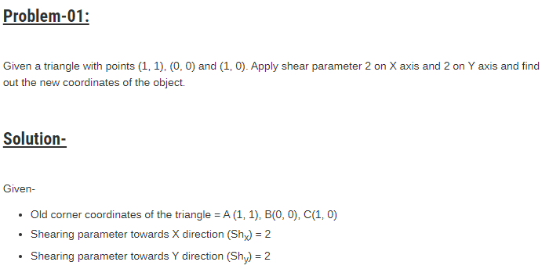

Slide 37
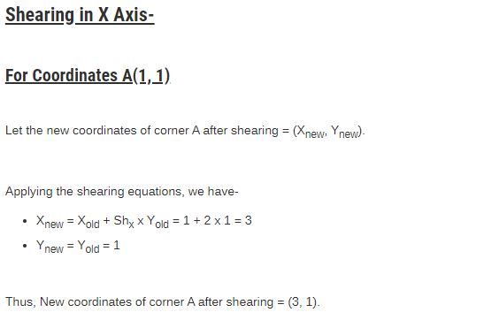

Slide 38
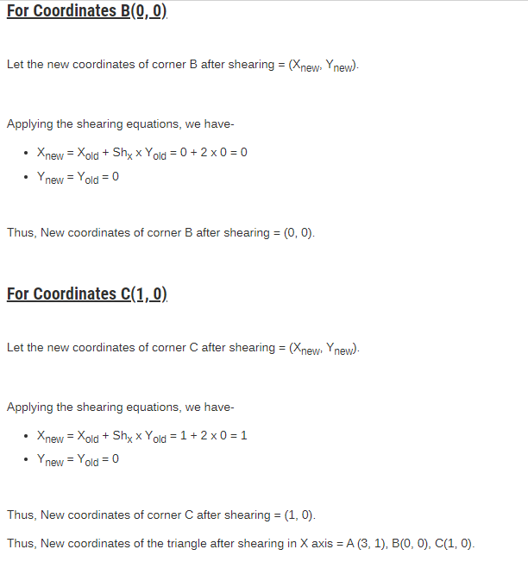

Slide 39
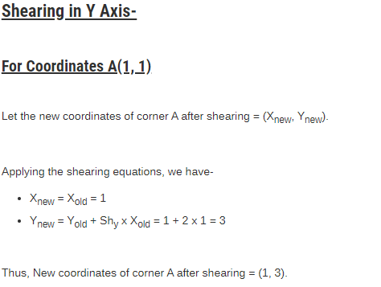

Slide 40
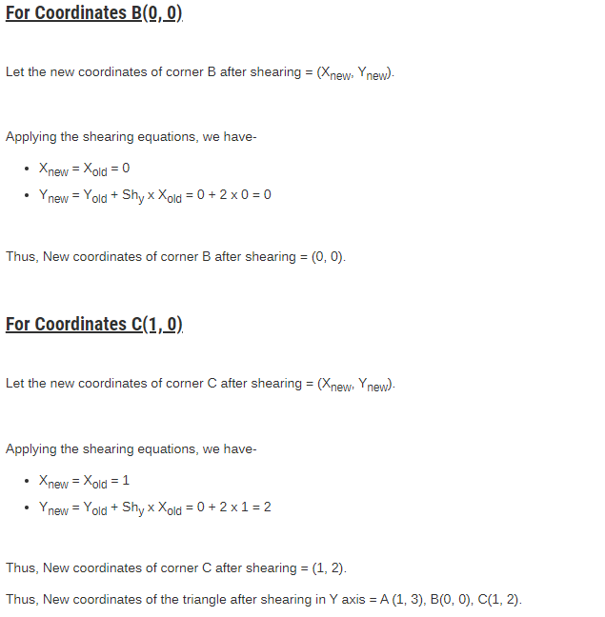

Slide 41
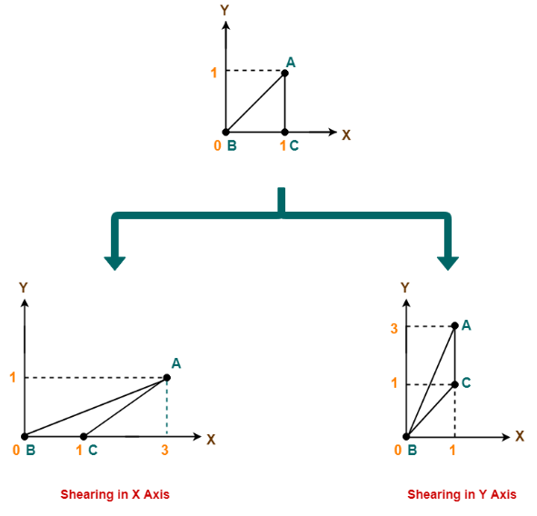

Slide 42
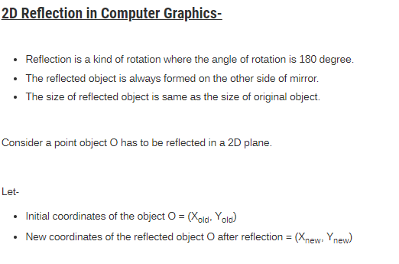

Slide 43
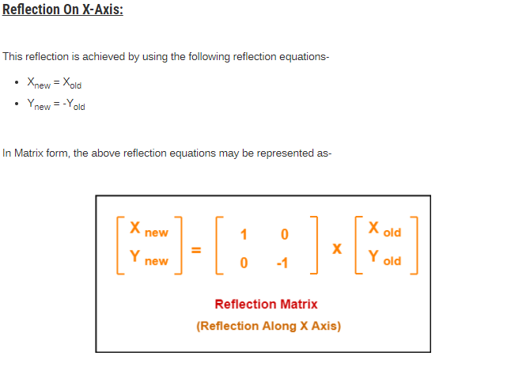
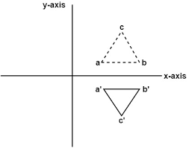

Slide 44


Slide 45



Slide 46


Slide 47


Slide 48



Slide 49


Slide 50



Slide 51



Slide 52


Slide 53



Slide 54

MATRIX TRANSFORMATION

Slide 55

MATRIX TRANSFORMATION

Slide 56



Inverse transformations:
These are also called as opposite transformations. If T is a translation matrix than inverse translation is representing using T⁻¹. The inverse matrix is achieved using the opposite sign.
Inverse translation matrix
Two-Dimensional inverse rotation matrix
Two-Dimensional inverse scaling matrix

Slide 57
Composite Transformation
A number of transformations or sequence of transformations can be combined into single one called as composition. The resulting matrix is called as composite matrix. The process of combining is called as concatenation.
Suppose we want to perform rotation about an arbitrary point, then we can perform it by the sequence of three transformations
Translation
Rotation
Reverse Translation

Slide 58
Composite transformation
If a transformation of the plane T1 is followed by a second plane transformation T2, then the result itself may be represented by a single transformation T which is the composition of T1 and T2 taken in that order. This is written as T = T1∙T2.
Composite transformation can be achieved by concatenation of transformation matrices to obtain a combined transformation matrix.
A combined matrix −
[T][X] = [X] [T1] [T2] [T3] [T4] …. [Tn]

Slide 59


Slide 60


Where [Ti] is any combination of
Translation
Scaling
Shearing
Rotation
Reflection
The change in the order of transformation would lead to different results, as in general matrix multiplication is not cumulative, that is [A] . [B] ≠ [B] . [A] and the order of multiplication. The basic purpose of composing transformations is to gain efficiency by applying a single composed transformation to a point, rather than applying a series of transformation, one after another.
For example, to rotate an object about an arbitrary point (X_{p}, Y_{p}), we have to carry out three steps −
Translate point (X_{p}, Y_{p}) to the origin.
Rotate it about the origin.
Finally, translate the center of rotation back where it belonged.

Slide 61

Where [Ti] is any combination of
Translation
Scaling
Shearing
Rotation
Reflection
The change in the order of transformation would lead to different results, as in general matrix multiplication is not cumulative, that is [A] . [B] ≠ [B] . [A] and the order of multiplication. The basic purpose of composing transformations is to gain efficiency by applying a single composed transformation to a point, rather than applying a series of transformation, one after another.
For example, to rotate an object about an arbitrary point (X_{p}, Y_{p}), we have to carry out three steps −
Translate point (X_{p}, Y_{p}) to the origin.
Rotate it about the origin.
Finally, translate the center of rotation back where it belonged.

Slide 62


Slide 63


Slide 64


Slide 65


Slide 66


Slide 67



Slide 68



Slide 69



Slide 70



Slide 71



Slide 72



Slide 73



Slide 74


Slide 75



Slide 76
course
2-D Transformation: Translation, Rotation, Scaling, Shearing, Reflection. Inverse Transformation, Homogenous Coordinate System, Matrices Transformation, Composite Transformation. Windowing & Clipping: World Coordinate System, Screen Coordinate System, Viewing Transformation, Line Clipping & Polygon Clipping Algorithms.

Slide 77

Coordinate System
In a 2-D coordinate system the X axis generally points from left to right, and the Y axis generally points from bottom to top. ( Although some windowing systems will have their Y coordinates going from top to bottom. )

Slide 78


Windowing and Viewing

Slide 79

Windowing and Viewing

Slide 80

Windowing and Viewing

Slide 81


Slide 82


Slide 83


Slide 84


Slide 85


Slide 86


Slide 87


Slide 88


Slide 89

clipping
When a window is "placed" on the world, only certain objects and parts of objects can be seen. Points and lines which are outside the window are "cut off" from view. This process of "cutting off" parts of the image of the world is called Clipping.

Slide 90
Clipping window

Slide 91


Slide 92


Slide 93
Cohen Sutherland Line Clipping Algorithm:
first of all, it is detected whether line lies inside the screen or it is outside the screen. All lines come under any one of the following categories:
Visible
Not Visible
Clipping Case
1. Visible: If a line lies within the window, i.e., both endpoints of the line lies within the window. A line is visible and will be displayed as it is.
2. Not Visible: If a line lies outside the window it will be invisible and rejected. Such lines will not display. If any one of the following inequalities is satisfied, then the line is considered invisible. Let A (x₁,y₁) and B (x₂,y₂) are endpoints of line.

Slide 94
3. Clipping Case: If the line is neither visible case nor invisible case. It is considered to be clipped case. First of all, the category of a line is found based on nine regions given below. All nine regions are assigned codes. Each code is of 4 bits. If both endpoints of the line have end bits zero, then the line is considered to be visible.

Slide 95


Slide 96

The center area is having the code, 0000, i.e., region 5 is considered a rectangle window

Slide 97



Slide 98

Line AB is the visible case Line OP is an invisible case Line PQ is an invisible line Line IJ are clipping candidates Line MN are clipping candidate Line CD are clipping candidate

Slide 99


Slide 100



Slide 101



Slide 102


Slide 103


Slide 104


Slide 105


Slide 106



Slide 107


Slide 108
Polygon clipping
“A Polygon can be described as the enclosed collection or group of the lines.”
In a polygon, all lines are connected. Lines can be a combination of edges and vertices, which together form a polygon. A polygon refers to a two-dimensional architecture made up of a number of straight lines.
Polygon clipping is a process in which we only consider the part which is inside the view pane or window. We will remove or clip the part that is outside the window

Slide 109

Polygon clipping

Slide 110



Slide 111

Sutherland-Hodgeman Polygon Clipping:
Sutherland Hodgeman polygon clipping algorithm is used for polygon clipping. In this algorithm, all the vertices of the polygon are clipped against each edge of the clipping window.
First the polygon is clipped against the left edge of the polygon window to get new vertices of the polygon. These new vertices are used to clip the polygon against right edge, top edge, bottom edge,

Slide 112


Slide 113

There should be the following conditions while we clip a polygon.
Condition 1(Out-In): If the first vertex of the polygon is outside and the second vertex is inside the window, then the output will be the intersection point and second vertex.

Slide 114

There should be the following conditions while we clip a polygon.
Condition 2(In-Out): If the first vertex of the polygon is inside and the second vertex is outside the window, then the output will be the intersection point.
V1
V2

Slide 115

There should be the following conditions while we clip a polygon.
Condition 3(In-In): If both vertices of the polygon are inside the window, then the output will be the second vertex.

Slide 116

There should be the following conditions while we clip a polygon.
Condition 4(Out-Out): If both vertices of the polygon are outside the window, then the output will be nothing. It means we found a clipped polygon.

Slide 117
THANK YOU

